Slide 1
Lecture 8 – Introduction to Computer Vision
AY 2024-25

Slide 2
Lesson Outline
L8 – Introduction to Computer Vision
Computer Vision: An Overview
OpenCV
CV Models

Slide 3
Computer Vision
Computer vision is a field of artificial intelligence (AI) that enables computers and systems to derive meaningful information from digital images, videos and other visual inputs — and take actions or make recommendations based on that information.
If AI enables computers to think, computer vision enables them to see, observe and understand.

Slide 4
Computer Vision
Computers can see the world through digital images, such as photographs, live camera feeds, or recorded video files.
Each digital image is actually an array of numeric values indicating the color intensity of each pixel in the image. You can use these values just like any other data as features to train a machine learning model, or to apply transformations and calculations to analyze the image data and find patterns in it.
A grid of numbers is overlaid on the image – each number is a value between 0 and 255, representing the intensity of each pixel
In the case of color images, there are three layers of pixel values for red, green, and blue intensities. (Three overlapping tables of red, green, and blue pixel values)

Slide 5
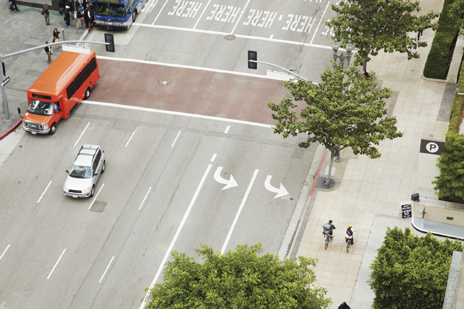
Introduction to Computer Vision (2)
0 | 255 | 0 | 255 | 0 | 255 | 0 | 255 | 0 | 255 | 0 | 255 | 0 | 255 | 0 | 255 | 0 | 255 | 0 | 255 | 0 | 255 | 0 | 255 | 0 | 255 | 0 | 255 | 0 | 255 | 0 | 255 | 0 | 255 | 0 | 255 | 0
0 | 255 | 0 | 255 | 0 | 255 | 0 | 255 | 0 | 255 | 0 | 255 | 0 | 255 | 0 | 255 | 0 | 255 | 0 | 255 | 0 | 255 | 0 | 255 | 0 | 255 | 0 | 255 | 0 | 255 | 0 | 255 | 0 | 255 | 0 | 255 | 0
0 | 255 | 0 | 255 | 0 | 255 | 0 | 255 | 0 | 255 | 0 | 255 | 0 | 255 | 0 | 255 | 0 | 255 | 0 | 255 | 0 | 255 | 0 | 255 | 0 | 255 | 0 | 255 | 0 | 255 | 0 | 255 | 0 | 255 | 0 | 255 | 0
0 | 255 | 0 | 255 | 0 | 255 | 0 | 255 | 0 | 255 | 0 | 255 | 0 | 255 | 0 | 255 | 0 | 255 | 0 | 255 | 0 | 255 | 0 | 255 | 0 | 255 | 0 | 255 | 0 | 255 | 0 | 255 | 0 | 255 | 0 | 255 | 0
0 | 255 | 0 | 255 | 0 | 255 | 0 | 255 | 0 | 255 | 0 | 255 | 0 | 255 | 0 | 255 | 0 | 255 | 0 | 255 | 0 | 255 | 0 | 255 | 0 | 255 | 0 | 255 | 0 | 255 | 0 | 255 | 0 | 255 | 0 | 255 | 0
0 | 255 | 0 | 255 | 0 | 255 | 0 | 255 | 0 | 255 | 0 | 255 | 0 | 255 | 0 | 255 | 0 | 255 | 0 | 255 | 0 | 255 | 0 | 255 | 0 | 255 | 0 | 255 | 0 | 255 | 0 | 255 | 0 | 255 | 0 | 255 | 0
0 | 255 | 0 | 255 | 0 | 255 | 0 | 255 | 0 | 255 | 0 | 255 | 0 | 255 | 0 | 255 | 0 | 255 | 0 | 255 | 0 | 255 | 0 | 255 | 0 | 255 | 0 | 255 | 0 | 255 | 0 | 255 | 0 | 255 | 0 | 255 | 0
0 | 255 | 0 | 255 | 0 | 255 | 0 | 255 | 0 | 255 | 0 | 255 | 0 | 255 | 0 | 255 | 0 | 255 | 0 | 255 | 0 | 255 | 0 | 255 | 0 | 255 | 0 | 255 | 0 | 255 | 0 | 255 | 0 | 255 | 0 | 255 | 0
0 | 255 | 0 | 255 | 0 | 255 | 0 | 255 | 0 | 255 | 0 | 255 | 0 | 255 | 0 | 255 | 0 | 255 | 0 | 255 | 0 | 255 | 0 | 255 | 0 | 255 | 0 | 255 | 0 | 255 | 0 | 255 | 0 | 255 | 0 | 255 | 0
0 | 255 | 0 | 255 | 0 | 255 | 0 | 255 | 0 | 255 | 0 | 255 | 0 | 255 | 0 | 255 | 0 | 255 | 0 | 255 | 0 | 255 | 0 | 255 | 0 | 255 | 0 | 255 | 0 | 255 | 0 | 255 | 0 | 255 | 0 | 255 | 0
0 | 255 | 0 | 255 | 0 | 255 | 0 | 255 | 0 | 255 | 0 | 255 | 0 | 255 | 0 | 255 | 0 | 255 | 0 | 255 | 0 | 255 | 0 | 255 | 0 | 255 | 0 | 255 | 0 | 255 | 0 | 255 | 0 | 255 | 0 | 255 | 0
0 | 255 | 0 | 255 | 0 | 255 | 0 | 255 | 0 | 255 | 0 | 255 | 0 | 255 | 0 | 255 | 0 | 255 | 0 | 255 | 0 | 255 | 0 | 255 | 0 | 255 | 0 | 255 | 0 | 255 | 0 | 255 | 0 | 255 | 0 | 255 | 0
0 | 255 | 0 | 255 | 0 | 255 | 0 | 255 | 0 | 255 | 0 | 255 | 0 | 255 | 0 | 255 | 0 | 255 | 0 | 255 | 0 | 255 | 0 | 255 | 0 | 255 | 0 | 255 | 0 | 255 | 0 | 255 | 0 | 255 | 0 | 255 | 0
0 | 255 | 0 | 255 | 0 | 255 | 0 | 255 | 0 | 255 | 0 | 255 | 0 | 255 | 0 | 255 | 0 | 255 | 0 | 255 | 0 | 255 | 0 | 255 | 0 | 255 | 0 | 255 | 0 | 255 | 0 | 255 | 0 | 255 | 0 | 255 | 0
0 | 255 | 0 | 255 | 0 | 255 | 0 | 255 | 0 | 255 | 0 | 255 | 0 | 255 | 0 | 255 | 0 | 255 | 0 | 255 | 0 | 255 | 0 | 255 | 0 | 255 | 0 | 255 | 0 | 255 | 0 | 255 | 0 | 255 | 0 | 255 | 0
0 | 255 | 0 | 255 | 0 | 255 | 0 | 255 | 0 | 255 | 0 | 255 | 0 | 255 | 0 | 255 | 0 | 255 | 0 | 255 | 0 | 255 | 0 | 255 | 0 | 255 | 0 | 255 | 0 | 255 | 0 | 255 | 0 | 255 | 0 | 255 | 0
0 | 255 | 0 | 255 | 0 | 255 | 0 | 255 | 0 | 255 | 0 | 255 | 0 | 255 | 0 | 255 | 0 | 255 | 0 | 255 | 0 | 255 | 0 | 255 | 0 | 255 | 0 | 255 | 0 | 255 | 0 | 255 | 0 | 255 | 0 | 255 | 0
0 | 255 | 0 | 255 | 0 | 255 | 0 | 255 | 0 | 255 | 0 | 255 | 0 | 255 | 0 | 255 | 0 | 255 | 0 | 255 | 0 | 255 | 0 | 255 | 0 | 255 | 0 | 255 | 0 | 255 | 0 | 255 | 0 | 255 | 0 | 255 | 0
0 | 255 | 0 | 255 | 0 | 255 | 0 | 255 | 0 | 255 | 0 | 255 | 0 | 255 | 0 | 255 | 0 | 255 | 0 | 255 | 0 | 255 | 0 | 255 | 0 | 255 | 0 | 255 | 0 | 255 | 0 | 255 | 0 | 255 | 0 | 255 | 0
0 | 255 | 0 | 255 | 0 | 255 | 0 | 255 | 0 | 255 | 0 | 255 | 0 | 255 | 0 | 255 | 0 | 255 | 0 | 255 | 0 | 255 | 0 | 255 | 0 | 255 | 0 | 255 | 0 | 255 | 0 | 255 | 0 | 255 | 0 | 255 | 0
0 | 255 | 0 | 255 | 0 | 255 | 0 | 255 | 0 | 255 | 0 | 255 | 0 | 255 | 0 | 255 | 0 | 255 | 0 | 255 | 0 | 255 | 0 | 255 | 0 | 255 | 0 | 255 | 0 | 255 | 0 | 255 | 0 | 255 | 0 | 255 | 0
Black and white

Slide 6
Introduction to Computer Vision (3)
0 | 255 | 0 | 255 | 0 | 255 | 0 | 255 | 0 | 255 | 0 | 255 | 0 | 255 | 0 | 255 | 0 | 255 | 0 | 255 | 0 | 255 | 0 | 255 | 0 | 255 | 0 | 255 | 0 | 255 | 0 | 255 | 0 | 255 | 0 | 255 | 0
0 | 255 | 0 | 255 | 0 | 255 | 0 | 255 | 0 | 255 | 0 | 255 | 0 | 255 | 0 | 255 | 0 | 255 | 0 | 255 | 0 | 255 | 0 | 255 | 0 | 255 | 0 | 255 | 0 | 255 | 0 | 255 | 0 | 255 | 0 | 255 | 0
0 | 255 | 0 | 255 | 0 | 255 | 0 | 255 | 0 | 255 | 0 | 255 | 0 | 255 | 0 | 255 | 0 | 255 | 0 | 255 | 0 | 255 | 0 | 255 | 0 | 255 | 0 | 255 | 0 | 255 | 0 | 255 | 0 | 255 | 0 | 255 | 0
0 | 255 | 0 | 255 | 0 | 255 | 0 | 255 | 0 | 255 | 0 | 255 | 0 | 255 | 0 | 255 | 0 | 255 | 0 | 255 | 0 | 255 | 0 | 255 | 0 | 255 | 0 | 255 | 0 | 255 | 0 | 255 | 0 | 255 | 0 | 255 | 0
0 | 255 | 0 | 255 | 0 | 255 | 0 | 255 | 0 | 255 | 0 | 255 | 0 | 255 | 0 | 255 | 0 | 255 | 0 | 255 | 0 | 255 | 0 | 255 | 0 | 255 | 0 | 255 | 0 | 255 | 0 | 255 | 0 | 255 | 0 | 255 | 0
0 | 255 | 0 | 255 | 0 | 255 | 0 | 255 | 0 | 255 | 0 | 255 | 0 | 255 | 0 | 255 | 0 | 255 | 0 | 255 | 0 | 255 | 0 | 255 | 0 | 255 | 0 | 255 | 0 | 255 | 0 | 255 | 0 | 255 | 0 | 255 | 0
0 | 255 | 0 | 255 | 0 | 255 | 0 | 255 | 0 | 255 | 0 | 255 | 0 | 255 | 0 | 255 | 0 | 255 | 0 | 255 | 0 | 255 | 0 | 255 | 0 | 255 | 0 | 255 | 0 | 255 | 0 | 255 | 0 | 255 | 0 | 255 | 0
0 | 255 | 0 | 255 | 0 | 255 | 0 | 255 | 0 | 255 | 0 | 255 | 0 | 255 | 0 | 255 | 0 | 255 | 0 | 255 | 0 | 255 | 0 | 255 | 0 | 255 | 0 | 255 | 0 | 255 | 0 | 255 | 0 | 255 | 0 | 255 | 0
0 | 255 | 0 | 255 | 0 | 255 | 0 | 255 | 0 | 255 | 0 | 255 | 0 | 255 | 0 | 255 | 0 | 255 | 0 | 255 | 0 | 255 | 0 | 255 | 0 | 255 | 0 | 255 | 0 | 255 | 0 | 255 | 0 | 255 | 0 | 255 | 0
0 | 255 | 0 | 255 | 0 | 255 | 0 | 255 | 0 | 255 | 0 | 255 | 0 | 255 | 0 | 255 | 0 | 255 | 0 | 255 | 0 | 255 | 0 | 255 | 0 | 255 | 0 | 255 | 0 | 255 | 0 | 255 | 0 | 255 | 0 | 255 | 0
0 | 255 | 0 | 255 | 0 | 255 | 0 | 255 | 0 | 255 | 0 | 255 | 0 | 255 | 0 | 255 | 0 | 255 | 0 | 255 | 0 | 255 | 0 | 255 | 0 | 255 | 0 | 255 | 0 | 255 | 0 | 255 | 0 | 255 | 0 | 255 | 0
0 | 255 | 0 | 255 | 0 | 255 | 0 | 255 | 0 | 255 | 0 | 255 | 0 | 255 | 0 | 255 | 0 | 255 | 0 | 255 | 0 | 255 | 0 | 255 | 0 | 255 | 0 | 255 | 0 | 255 | 0 | 255 | 0 | 255 | 0 | 255 | 0
0 | 255 | 0 | 255 | 0 | 255 | 0 | 255 | 0 | 255 | 0 | 255 | 0 | 255 | 0 | 255 | 0 | 255 | 0 | 255 | 0 | 255 | 0 | 255 | 0 | 255 | 0 | 255 | 0 | 255 | 0 | 255 | 0 | 255 | 0 | 255 | 0
0 | 255 | 0 | 255 | 0 | 255 | 0 | 255 | 0 | 255 | 0 | 255 | 0 | 255 | 0 | 255 | 0 | 255 | 0 | 255 | 0 | 255 | 0 | 255 | 0 | 255 | 0 | 255 | 0 | 255 | 0 | 255 | 0 | 255 | 0 | 255 | 0
0 | 255 | 0 | 255 | 0 | 255 | 0 | 255 | 0 | 255 | 0 | 255 | 0 | 255 | 0 | 255 | 0 | 255 | 0 | 255 | 0 | 255 | 0 | 255 | 0 | 255 | 0 | 255 | 0 | 255 | 0 | 255 | 0 | 255 | 0 | 255 | 0
0 | 255 | 0 | 255 | 0 | 255 | 0 | 255 | 0 | 255 | 0 | 255 | 0 | 255 | 0 | 255 | 0 | 255 | 0 | 255 | 0 | 255 | 0 | 255 | 0 | 255 | 0 | 255 | 0 | 255 | 0 | 255 | 0 | 255 | 0 | 255 | 0
0 | 255 | 0 | 255 | 0 | 255 | 0 | 255 | 0 | 255 | 0 | 255 | 0 | 255 | 0 | 255 | 0 | 255 | 0 | 255 | 0 | 255 | 0 | 255 | 0 | 255 | 0 | 255 | 0 | 255 | 0 | 255 | 0 | 255 | 0 | 255 | 0
0 | 255 | 0 | 255 | 0 | 255 | 0 | 255 | 0 | 255 | 0 | 255 | 0 | 255 | 0 | 255 | 0 | 255 | 0 | 255 | 0 | 255 | 0 | 255 | 0 | 255 | 0 | 255 | 0 | 255 | 0 | 255 | 0 | 255 | 0 | 255 | 0
0 | 255 | 0 | 255 | 0 | 255 | 0 | 255 | 0 | 255 | 0 | 255 | 0 | 255 | 0 | 255 | 0 | 255 | 0 | 255 | 0 | 255 | 0 | 255 | 0 | 255 | 0 | 255 | 0 | 255 | 0 | 255 | 0 | 255 | 0 | 255 | 0
0 | 255 | 0 | 255 | 0 | 255 | 0 | 255 | 0 | 255 | 0 | 255 | 0 | 255 | 0 | 255 | 0 | 255 | 0 | 255 | 0 | 255 | 0 | 255 | 0 | 255 | 0 | 255 | 0 | 255 | 0 | 255 | 0 | 255 | 0 | 255 | 0
0 | 255 | 0 | 255 | 0 | 255 | 0 | 255 | 0 | 255 | 0 | 255 | 0 | 255 | 0 | 255 | 0 | 255 | 0 | 255 | 0 | 255 | 0 | 255 | 0 | 255 | 0 | 255 | 0 | 255 | 0 | 255 | 0 | 255 | 0 | 255 | 0
0 | 255 | 0 | 255 | 0 | 255 | 0 | 255 | 0 | 255 | 0 | 255 | 0 | 255 | 0 | 255 | 0 | 255 | 0 | 255 | 0 | 255 | 0 | 255 | 0 | 255 | 0 | 255 | 0 | 255 | 0 | 255 | 0 | 255 | 0 | 255 | 0
0 | 255 | 0 | 255 | 0 | 255 | 0 | 255 | 0 | 255 | 0 | 255 | 0 | 255 | 0 | 255 | 0 | 255 | 0 | 255 | 0 | 255 | 0 | 255 | 0 | 255 | 0 | 255 | 0 | 255 | 0 | 255 | 0 | 255 | 0 | 255 | 0
0 | 255 | 0 | 255 | 0 | 255 | 0 | 255 | 0 | 255 | 0 | 255 | 0 | 255 | 0 | 255 | 0 | 255 | 0 | 255 | 0 | 255 | 0 | 255 | 0 | 255 | 0 | 255 | 0 | 255 | 0 | 255 | 0 | 255 | 0 | 255 | 0
0 | 255 | 0 | 255 | 0 | 255 | 0 | 255 | 0 | 255 | 0 | 255 | 0 | 255 | 0 | 255 | 0 | 255 | 0 | 255 | 0 | 255 | 0 | 255 | 0 | 255 | 0 | 255 | 0 | 255 | 0 | 255 | 0 | 255 | 0 | 255 | 0
0 | 255 | 0 | 255 | 0 | 255 | 0 | 255 | 0 | 255 | 0 | 255 | 0 | 255 | 0 | 255 | 0 | 255 | 0 | 255 | 0 | 255 | 0 | 255 | 0 | 255 | 0 | 255 | 0 | 255 | 0 | 255 | 0 | 255 | 0 | 255 | 0
0 | 255 | 0 | 255 | 0 | 255 | 0 | 255 | 0 | 255 | 0 | 255 | 0 | 255 | 0 | 255 | 0 | 255 | 0 | 255 | 0 | 255 | 0 | 255 | 0 | 255 | 0 | 255 | 0 | 255 | 0 | 255 | 0 | 255 | 0 | 255 | 0
0 | 255 | 0 | 255 | 0 | 255 | 0 | 255 | 0 | 255 | 0 | 255 | 0 | 255 | 0 | 255 | 0 | 255 | 0 | 255 | 0 | 255 | 0 | 255 | 0 | 255 | 0 | 255 | 0 | 255 | 0 | 255 | 0 | 255 | 0 | 255 | 0
0 | 255 | 0 | 255 | 0 | 255 | 0 | 255 | 0 | 255 | 0 | 255 | 0 | 255 | 0 | 255 | 0 | 255 | 0 | 255 | 0 | 255 | 0 | 255 | 0 | 255 | 0 | 255 | 0 | 255 | 0 | 255 | 0 | 255 | 0 | 255 | 0
0 | 255 | 0 | 255 | 0 | 255 | 0 | 255 | 0 | 255 | 0 | 255 | 0 | 255 | 0 | 255 | 0 | 255 | 0 | 255 | 0 | 255 | 0 | 255 | 0 | 255 | 0 | 255 | 0 | 255 | 0 | 255 | 0 | 255 | 0 | 255 | 0
0 | 255 | 0 | 255 | 0 | 255 | 0 | 255 | 0 | 255 | 0 | 255 | 0 | 255 | 0 | 255 | 0 | 255 | 0 | 255 | 0 | 255 | 0 | 255 | 0 | 255 | 0 | 255 | 0 | 255 | 0 | 255 | 0 | 255 | 0 | 255 | 0
0 | 255 | 0 | 255 | 0 | 255 | 0 | 255 | 0 | 255 | 0 | 255 | 0 | 255 | 0 | 255 | 0 | 255 | 0 | 255 | 0 | 255 | 0 | 255 | 0 | 255 | 0 | 255 | 0 | 255 | 0 | 255 | 0 | 255 | 0 | 255 | 0
0 | 255 | 0 | 255 | 0 | 255 | 0 | 255 | 0 | 255 | 0 | 255 | 0 | 255 | 0 | 255 | 0 | 255 | 0 | 255 | 0 | 255 | 0 | 255 | 0 | 255 | 0 | 255 | 0 | 255 | 0 | 255 | 0 | 255 | 0 | 255 | 0
0 | 255 | 0 | 255 | 0 | 255 | 0 | 255 | 0 | 255 | 0 | 255 | 0 | 255 | 0 | 255 | 0 | 255 | 0 | 255 | 0 | 255 | 0 | 255 | 0 | 255 | 0 | 255 | 0 | 255 | 0 | 255 | 0 | 255 | 0 | 255 | 0
0 | 255 | 0 | 255 | 0 | 255 | 0 | 255 | 0 | 255 | 0 | 255 | 0 | 255 | 0 | 255 | 0 | 255 | 0 | 255 | 0 | 255 | 0 | 255 | 0 | 255 | 0 | 255 | 0 | 255 | 0 | 255 | 0 | 255 | 0 | 255 | 0
0 | 255 | 0 | 255 | 0 | 255 | 0 | 255 | 0 | 255 | 0 | 255 | 0 | 255 | 0 | 255 | 0 | 255 | 0 | 255 | 0 | 255 | 0 | 255 | 0 | 255 | 0 | 255 | 0 | 255 | 0 | 255 | 0 | 255 | 0 | 255 | 0
0 | 255 | 0 | 255 | 0 | 255 | 0 | 255 | 0 | 255 | 0 | 255 | 0 | 255 | 0 | 255 | 0 | 255 | 0 | 255 | 0 | 255 | 0 | 255 | 0 | 255 | 0 | 255 | 0 | 255 | 0 | 255 | 0 | 255 | 0 | 255 | 0
0 | 255 | 0 | 255 | 0 | 255 | 0 | 255 | 0 | 255 | 0 | 255 | 0 | 255 | 0 | 255 | 0 | 255 | 0 | 255 | 0 | 255 | 0 | 255 | 0 | 255 | 0 | 255 | 0 | 255 | 0 | 255 | 0 | 255 | 0 | 255 | 0
0 | 255 | 0 | 255 | 0 | 255 | 0 | 255 | 0 | 255 | 0 | 255 | 0 | 255 | 0 | 255 | 0 | 255 | 0 | 255 | 0 | 255 | 0 | 255 | 0 | 255 | 0 | 255 | 0 | 255 | 0 | 255 | 0 | 255 | 0 | 255 | 0
0 | 255 | 0 | 255 | 0 | 255 | 0 | 255 | 0 | 255 | 0 | 255 | 0 | 255 | 0 | 255 | 0 | 255 | 0 | 255 | 0 | 255 | 0 | 255 | 0 | 255 | 0 | 255 | 0 | 255 | 0 | 255 | 0 | 255 | 0 | 255 | 0
0 | 255 | 0 | 255 | 0 | 255 | 0 | 255 | 0 | 255 | 0 | 255 | 0 | 255 | 0 | 255 | 0 | 255 | 0 | 255 | 0 | 255 | 0 | 255 | 0 | 255 | 0 | 255 | 0 | 255 | 0 | 255 | 0 | 255 | 0 | 255 | 0
0 | 255 | 0 | 255 | 0 | 255 | 0 | 255 | 0 | 255 | 0 | 255 | 0 | 255 | 0 | 255 | 0 | 255 | 0 | 255 | 0 | 255 | 0 | 255 | 0 | 255 | 0 | 255 | 0 | 255 | 0 | 255 | 0 | 255 | 0 | 255 | 0
0 | 255 | 0 | 255 | 0 | 255 | 0 | 255 | 0 | 255 | 0 | 255 | 0 | 255 | 0 | 255 | 0 | 255 | 0 | 255 | 0 | 255 | 0 | 255 | 0 | 255 | 0 | 255 | 0 | 255 | 0 | 255 | 0 | 255 | 0 | 255 | 0
0 | 255 | 0 | 255 | 0 | 255 | 0 | 255 | 0 | 255 | 0 | 255 | 0 | 255 | 0 | 255 | 0 | 255 | 0 | 255 | 0 | 255 | 0 | 255 | 0 | 255 | 0 | 255 | 0 | 255 | 0 | 255 | 0 | 255 | 0 | 255 | 0
0 | 255 | 0 | 255 | 0 | 255 | 0 | 255 | 0 | 255 | 0 | 255 | 0 | 255 | 0 | 255 | 0 | 255 | 0 | 255 | 0 | 255 | 0 | 255 | 0 | 255 | 0 | 255 | 0 | 255 | 0 | 255 | 0 | 255 | 0 | 255 | 0
0 | 255 | 0 | 255 | 0 | 255 | 0 | 255 | 0 | 255 | 0 | 255 | 0 | 255 | 0 | 255 | 0 | 255 | 0 | 255 | 0 | 255 | 0 | 255 | 0 | 255 | 0 | 255 | 0 | 255 | 0 | 255 | 0 | 255 | 0 | 255 | 0
0 | 255 | 0 | 255 | 0 | 255 | 0 | 255 | 0 | 255 | 0 | 255 | 0 | 255 | 0 | 255 | 0 | 255 | 0 | 255 | 0 | 255 | 0 | 255 | 0 | 255 | 0 | 255 | 0 | 255 | 0 | 255 | 0 | 255 | 0 | 255 | 0
0 | 255 | 0 | 255 | 0 | 255 | 0 | 255 | 0 | 255 | 0 | 255 | 0 | 255 | 0 | 255 | 0 | 255 | 0 | 255 | 0 | 255 | 0 | 255 | 0 | 255 | 0 | 255 | 0 | 255 | 0 | 255 | 0 | 255 | 0 | 255 | 0
0 | 255 | 0 | 255 | 0 | 255 | 0 | 255 | 0 | 255 | 0 | 255 | 0 | 255 | 0 | 255 | 0 | 255 | 0 | 255 | 0 | 255 | 0 | 255 | 0 | 255 | 0 | 255 | 0 | 255 | 0 | 255 | 0 | 255 | 0 | 255 | 0
0 | 255 | 0 | 255 | 0 | 255 | 0 | 255 | 0 | 255 | 0 | 255 | 0 | 255 | 0 | 255 | 0 | 255 | 0 | 255 | 0 | 255 | 0 | 255 | 0 | 255 | 0 | 255 | 0 | 255 | 0 | 255 | 0 | 255 | 0 | 255 | 0
0 | 255 | 0 | 255 | 0 | 255 | 0 | 255 | 0 | 255 | 0 | 255 | 0 | 255 | 0 | 255 | 0 | 255 | 0 | 255 | 0 | 255 | 0 | 255 | 0 | 255 | 0 | 255 | 0 | 255 | 0 | 255 | 0 | 255 | 0 | 255 | 0
0 | 255 | 0 | 255 | 0 | 255 | 0 | 255 | 0 | 255 | 0 | 255 | 0 | 255 | 0 | 255 | 0 | 255 | 0 | 255 | 0 | 255 | 0 | 255 | 0 | 255 | 0 | 255 | 0 | 255 | 0 | 255 | 0 | 255 | 0 | 255 | 0
0 | 255 | 0 | 255 | 0 | 255 | 0 | 255 | 0 | 255 | 0 | 255 | 0 | 255 | 0 | 255 | 0 | 255 | 0 | 255 | 0 | 255 | 0 | 255 | 0 | 255 | 0 | 255 | 0 | 255 | 0 | 255 | 0 | 255 | 0 | 255 | 0
0 | 255 | 0 | 255 | 0 | 255 | 0 | 255 | 0 | 255 | 0 | 255 | 0 | 255 | 0 | 255 | 0 | 255 | 0 | 255 | 0 | 255 | 0 | 255 | 0 | 255 | 0 | 255 | 0 | 255 | 0 | 255 | 0 | 255 | 0 | 255 | 0
0 | 255 | 0 | 255 | 0 | 255 | 0 | 255 | 0 | 255 | 0 | 255 | 0 | 255 | 0 | 255 | 0 | 255 | 0 | 255 | 0 | 255 | 0 | 255 | 0 | 255 | 0 | 255 | 0 | 255 | 0 | 255 | 0 | 255 | 0 | 255 | 0
0 | 255 | 0 | 255 | 0 | 255 | 0 | 255 | 0 | 255 | 0 | 255 | 0 | 255 | 0 | 255 | 0 | 255 | 0 | 255 | 0 | 255 | 0 | 255 | 0 | 255 | 0 | 255 | 0 | 255 | 0 | 255 | 0 | 255 | 0 | 255 | 0
0 | 255 | 0 | 255 | 0 | 255 | 0 | 255 | 0 | 255 | 0 | 255 | 0 | 255 | 0 | 255 | 0 | 255 | 0 | 255 | 0 | 255 | 0 | 255 | 0 | 255 | 0 | 255 | 0 | 255 | 0 | 255 | 0 | 255 | 0 | 255 | 0
0 | 255 | 0 | 255 | 0 | 255 | 0 | 255 | 0 | 255 | 0 | 255 | 0 | 255 | 0 | 255 | 0 | 255 | 0 | 255 | 0 | 255 | 0 | 255 | 0 | 255 | 0 | 255 | 0 | 255 | 0 | 255 | 0 | 255 | 0 | 255 | 0
0 | 255 | 0 | 255 | 0 | 255 | 0 | 255 | 0 | 255 | 0 | 255 | 0 | 255 | 0 | 255 | 0 | 255 | 0 | 255 | 0 | 255 | 0 | 255 | 0 | 255 | 0 | 255 | 0 | 255 | 0 | 255 | 0 | 255 | 0 | 255 | 0
0 | 255 | 0 | 255 | 0 | 255 | 0 | 255 | 0 | 255 | 0 | 255 | 0 | 255 | 0 | 255 | 0 | 255 | 0 | 255 | 0 | 255 | 0 | 255 | 0 | 255 | 0 | 255 | 0 | 255 | 0 | 255 | 0 | 255 | 0 | 255 | 0
0 | 255 | 0 | 255 | 0 | 255 | 0 | 255 | 0 | 255 | 0 | 255 | 0 | 255 | 0 | 255 | 0 | 255 | 0 | 255 | 0 | 255 | 0 | 255 | 0 | 255 | 0 | 255 | 0 | 255 | 0 | 255 | 0 | 255 | 0 | 255 | 0
0 | 255 | 0 | 255 | 0 | 255 | 0 | 255 | 0 | 255 | 0 | 255 | 0 | 255 | 0 | 255 | 0 | 255 | 0 | 255 | 0 | 255 | 0 | 255 | 0 | 255 | 0 | 255 | 0 | 255 | 0 | 255 | 0 | 255 | 0 | 255 | 0
0 | 255 | 0 | 255 | 0 | 255 | 0 | 255 | 0 | 255 | 0 | 255 | 0 | 255 | 0 | 255 | 0 | 255 | 0 | 255 | 0 | 255 | 0 | 255 | 0 | 255 | 0 | 255 | 0 | 255 | 0 | 255 | 0 | 255 | 0 | 255 | 0
Red
Green
Blue

Slide 7
Applications of Computer Vision
Image Classification
Object Detection
Semantic Segmentation
Image Analysis
Face Detection & Recognition
Optical Character Recognition

Slide 8
Image Classification
An image classification model uses the numeric pixel features to predict a class label for the image.

Slide 9
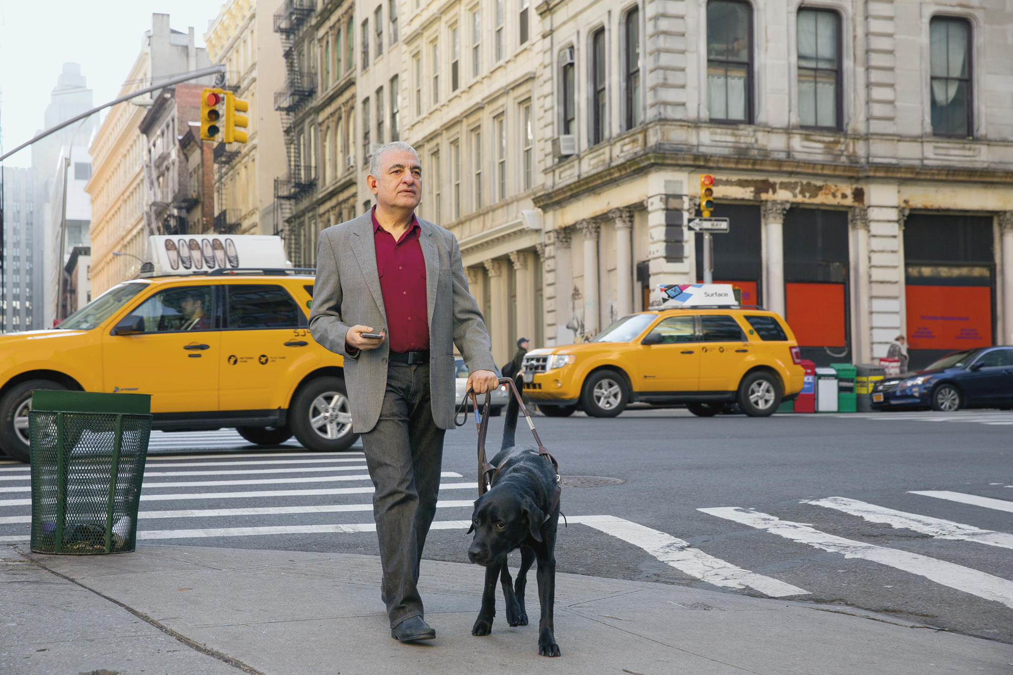
Image Classification (2)
For example, in a traffic monitoring solution you might use an image classification model to classify images based on the type of vehicle they contain, such as taxis, buses, cyclists, and so on. Essentially, image classification models answer the question "what is this an image of?"
An image of a taxi with the label "Taxi" is shown
Taxi

Slide 10
Object Detection
Object detection models are trained to classify individual objects in the image, and to indicate their location within the image as a bounding box.

Slide 11
Object Detection (2)
For example, you could expand the traffic monitoring solution to detect the presence of multiple classes of vehicle in an image. Object detection models are used to answer the question "what objects are in this image, and where are they?"
bus
bus
An image of a street with buses, cars, and cyclists indicated in bounding boxes is shown
Cyclist
car
Cyclist

Slide 12
Semantic Segmentation
Semantic segmentation models are an advanced kind of model that classify individual pixels in the image based on which object they belong to.

Slide 13
Semantic Segmentation
For example, the traffic monitoring solution might use a semantic segmentation model to overlay "masks" on the image to indicate pixels that belong to buses, cars, and cyclists with different colors. Semantic segmentation answers the question "which pixels belong to which object?".
An image of a street with buses, cars, and cyclists overlaid with colored masks is shown
bus
car
cyclist

Slide 14
Image Analysis
You can build on object detection and classification models to perform image analysis, generating captions and tags based on the image contents.
An image of a person and a dog on a street is shown with the caption "A person with a dog on a street"
A person with a dog on a street

Slide 15
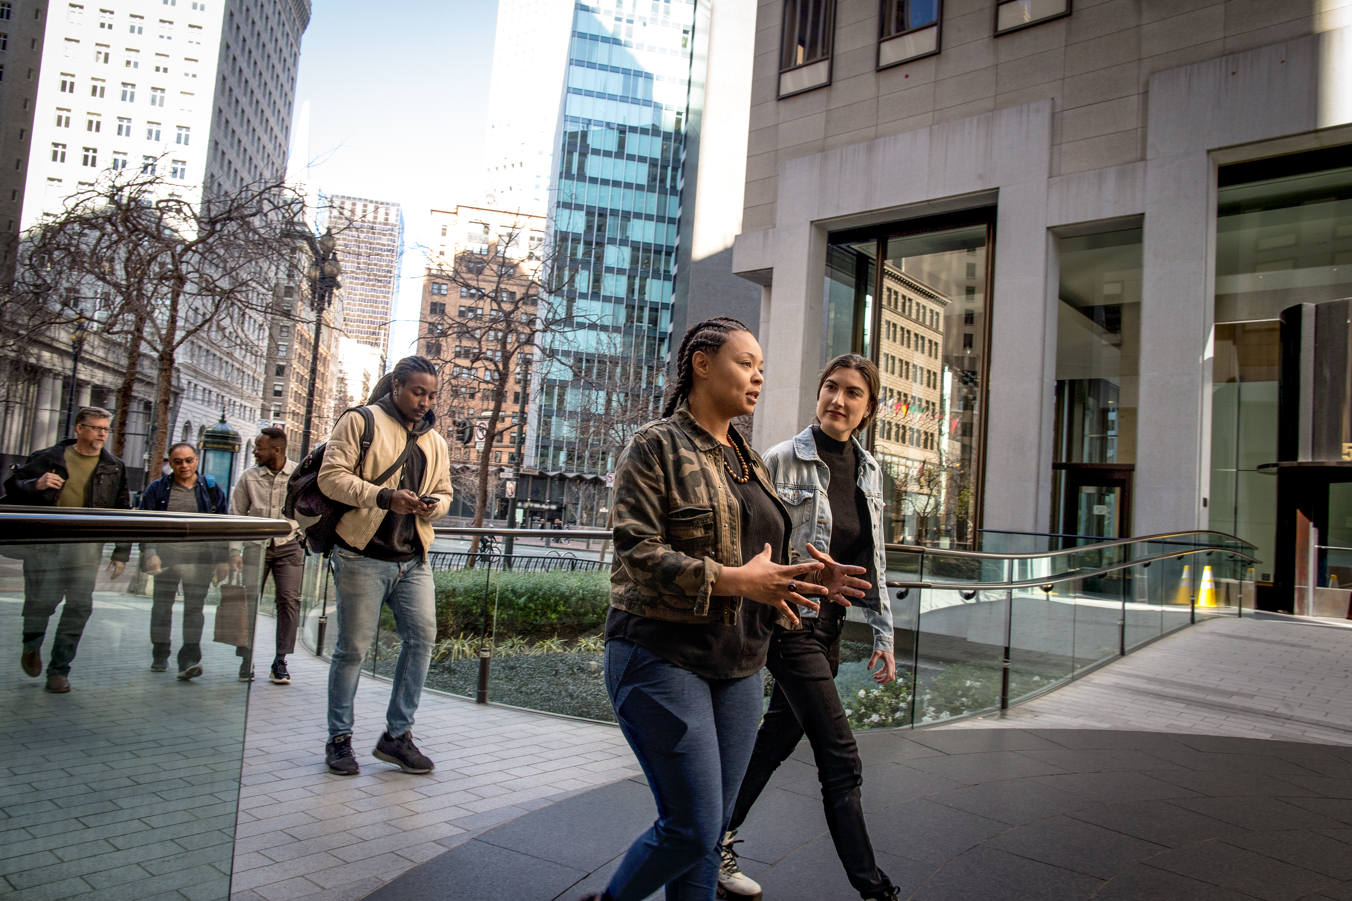
Face Detection & Recognition
Face detection is used to identify the location of human faces in an image. Further analysis can be performed on facial features to determine facial features, emotion, age, and so on; and models can be trained to identify specific individuals based on facial recognition.
An image of a group of people with their faces highlighted is shown

Slide 16
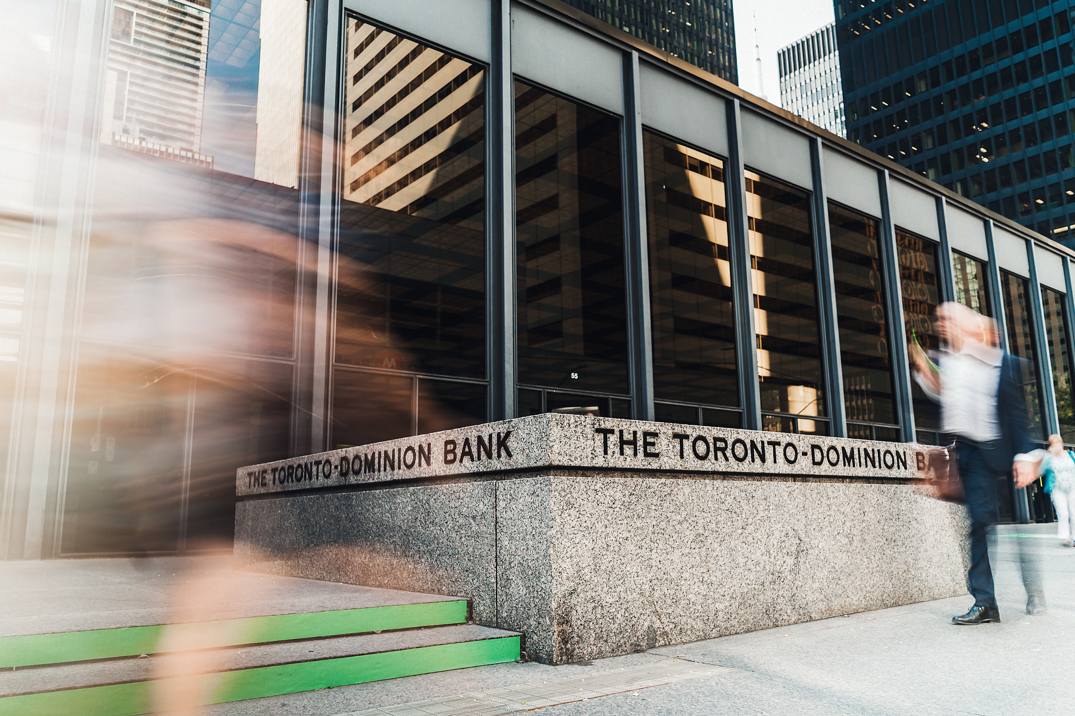
Optical Character Recognition
An OCR model identifies regions of the image that contain text and extracts them.
An image of a building with the sign "The Toronto Dominion Bank" is shown with the text highlighted
The Toronto Dominion Bank

Slide 17
2. OpenCV
What Is OpenCV?
Images and Pixels
Basic Operations

Slide 18

What Is OpenCV?
OpenCV is an open-course package and hence it’s free for both academic and commercial use.
It has C++, C, Python and Java interfaces and supports Windows, Linux, Mac OS, iOS and Android.
OpenCV was designed for computational efficiency and with a strong focus on real-time applications.
Written in optimized C/C++, the library can take advantage of multi-core processing.

Slide 19
Images and Pixels
An image consists of some picture elements, called pixels or pixel values.
In the case of color images, we have three colored channels.
Hence colored images will have multiple values for single-pixel values.
The color values go from 0 to 255.
These color channels are generally represented as Red Green Blue (RGB) for instance.

Slide 20
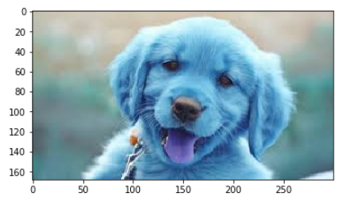
Basic Operations
Load and Show An Image
OpenCV_BasicOperations.ipynb
import cv2
import matplotlib.pyplot as plt
img = cv2.imread('images/puppy.jpg')
plt.imshow(img)

Slide 21
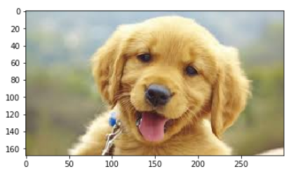
Basic Operations (2)
Load and Show An Image (2)
import cv2
img = cv2.imread("images/puppy.jpg")
img_rgb = cv2.cvtColor(img, cv2.COLOR_BGR2RGB)
plt.imshow(img_rgb)

Slide 22
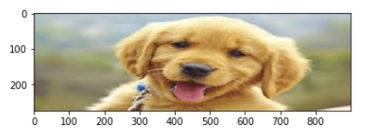
Basic Operations (3)
Resize An Image
import cv2
img_rgb = cv2.cvtColor(img, cv2.COLOR_BGR2RGB)
Img_rs = cv2.resize(img_rgb, (900, 275))
plt.imshow(img_rs)

Slide 23
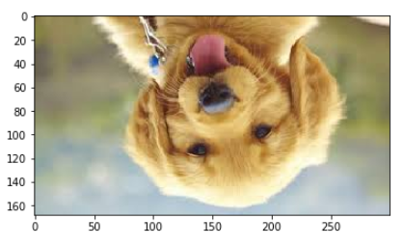
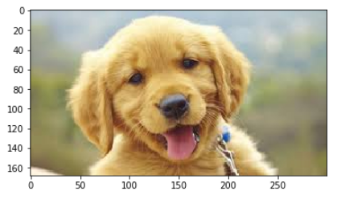
Basic Operations (4)
Image Rotation/Flipping
img_rgb = cv2.cvtColor(img, \
cv2.COLOR_BGR2RGB)
# Along central x-axis
new_img = cv2.flip(img_rgb, 0)
plt.imshow(new_img)
# Along central y-axis
new_img = cv2.flip(img_rgb, 1)
plt.imshow(new_img)

Slide 24
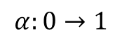
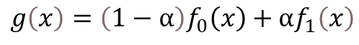
Basic Operations (5)
Blend Images
$$g\left(x\right)=\left(1−α\right)f_{0}\left(x\right)+αf_{1}\left(x\right)$$
$$α:0→1$$
import cv2
import matplotlib.pyplot as plt
img1 = cv2.imread('images/puppy2.jpg')
img2 = cv2.imread('images/do_not_copy.png')
img1 = cv2.cvtColor(img1, cv2.COLOR_BGR2RGB)
img2 = cv2.cvtColor(img2, cv2.COLOR_BGR2RGB)
img1 =cv2.resize(img1,(1200,1200))
img2 =cv2.resize(img2,(1200,1200))
blended = cv2.addWeighted(src1=img1, alpha=0.7, \
src2=img2, beta=0.3, gamma=0)
plt.figure(figsize=(8,8))
plt.imshow(blended)

Slide 25
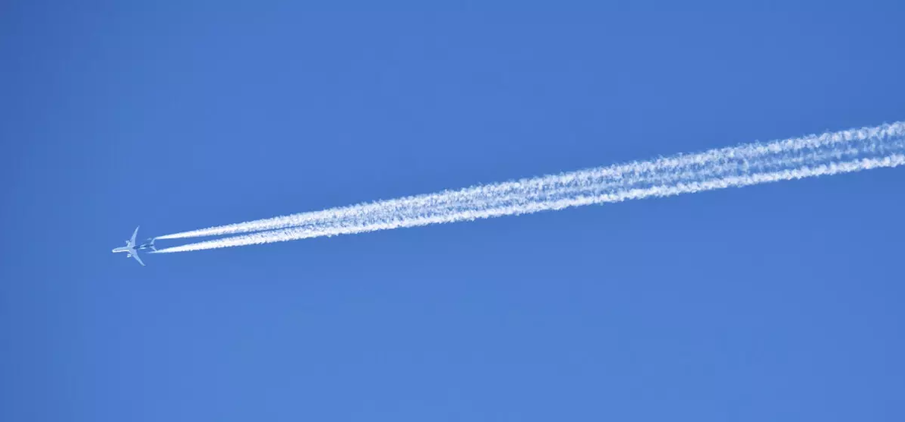



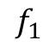
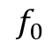
Basic Operations (6)
Blend Images
$$f_{0}$$
$$f_{1}$$
$$g$$

Slide 26
Basic Operations (7)
Edge Detection
import numpy as np
import cv2
import matplotlib.pyplot as plt
%matplotlib inline
def display_img(img):
fig = plt.figure(figsize=(8,6))
ax = fig.add_subplot(111)
ax.imshow(img,cmap='gray')

Slide 27
Basic Operations (8)
Edge Detection (2)
# read the image
image = cv2.imread('images/puppy2.jpg')
# calculate the edges using Canny edge algorithm
edges = cv2.Canny(image,100,200)
# plot the edges
display_img(edges)

Slide 28
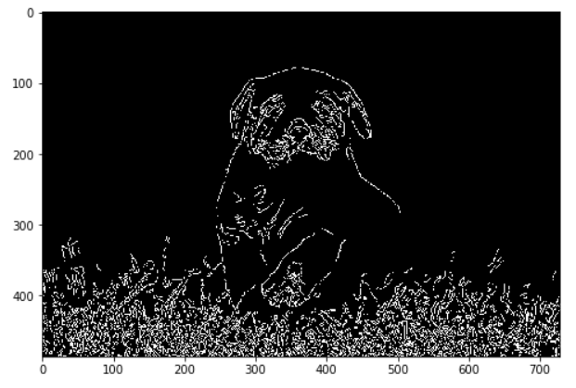
Basic Operations (9)
Edge Detection (3)

Slide 29
Basic Operations (10)
Face Detection
import numpy as np
import cv2
import matplotlib.pyplot as plt
smile = cv2.imread('images/smile.jpg', 0)
# OpenCV comes with these pre-trained cascade files
face_cascade = cv2.CascadeClassifier('haarcascades/ haarcascade_frontalface_default.xml')

Slide 30
Basic Operations (11)
Face Detection (2)
def detect_face(img):
face_img = img.copy()
face_rects = face_cascade.detectMultiScale(face_img)
for (x,y,w,h) in face_rects:
cv2.rectangle(face_img, (x,y), (x+w,y+h), \
(255,255,255), 3)
return face_img
result = detect_face(smile)
plt.imshow(result, cmap='gray')

Slide 31
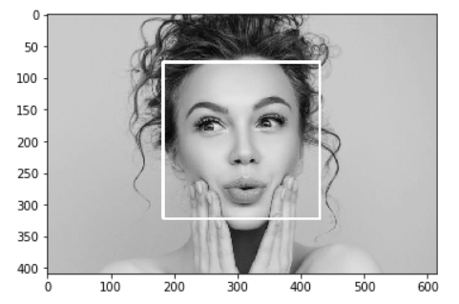
Basic Operations (12)
Face Detection (3)

Slide 32
Models
YOLO
Detectron2

Slide 33

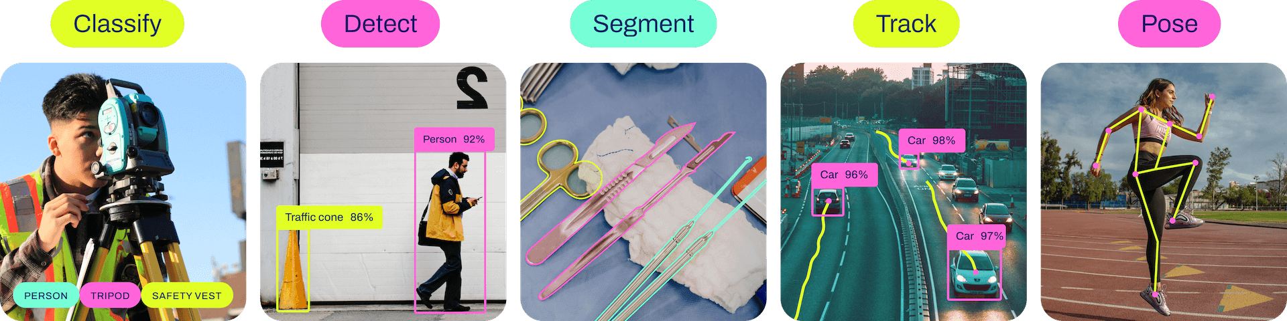
YOLO
YOLO (You Only Look Once) is an object detection algorithm that can be implemented in Python. It is designed to detect objects in images or video frames, providing bounding box coordinates and class labels for each detected object.
originally developed by Joseph Redmon and Ali Farhadi at the University of Washington in 2015
For the latest release, YOLOv8 was released on January 10, 2023
Reference link:
https://github.com/ultralytics/ultralytics

Slide 34
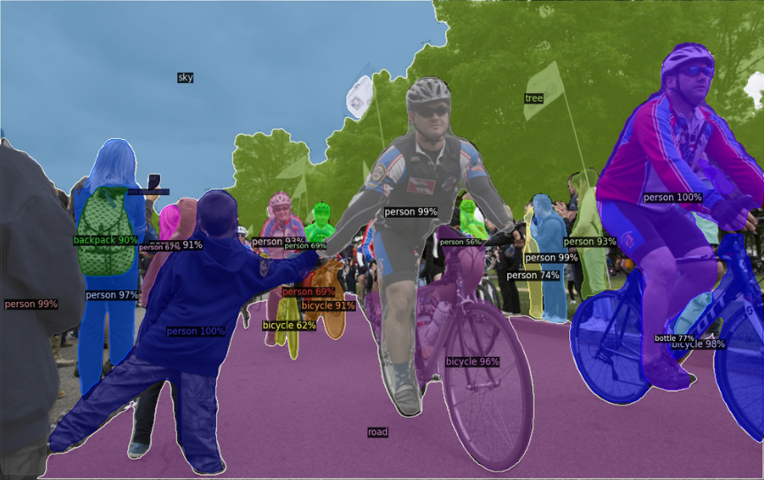
Detectron2
“Detectron2 is Facebook AI Research's next generation library that provides state-of-the-art detection and segmentation algorithms. It is the successor of Detectron and maskrcnn-benchmark. It supports a number of computer vision research projects and production applications in Facebook.”
Reference link:
https://github.com/facebookresearch/detectron2

Slide 35
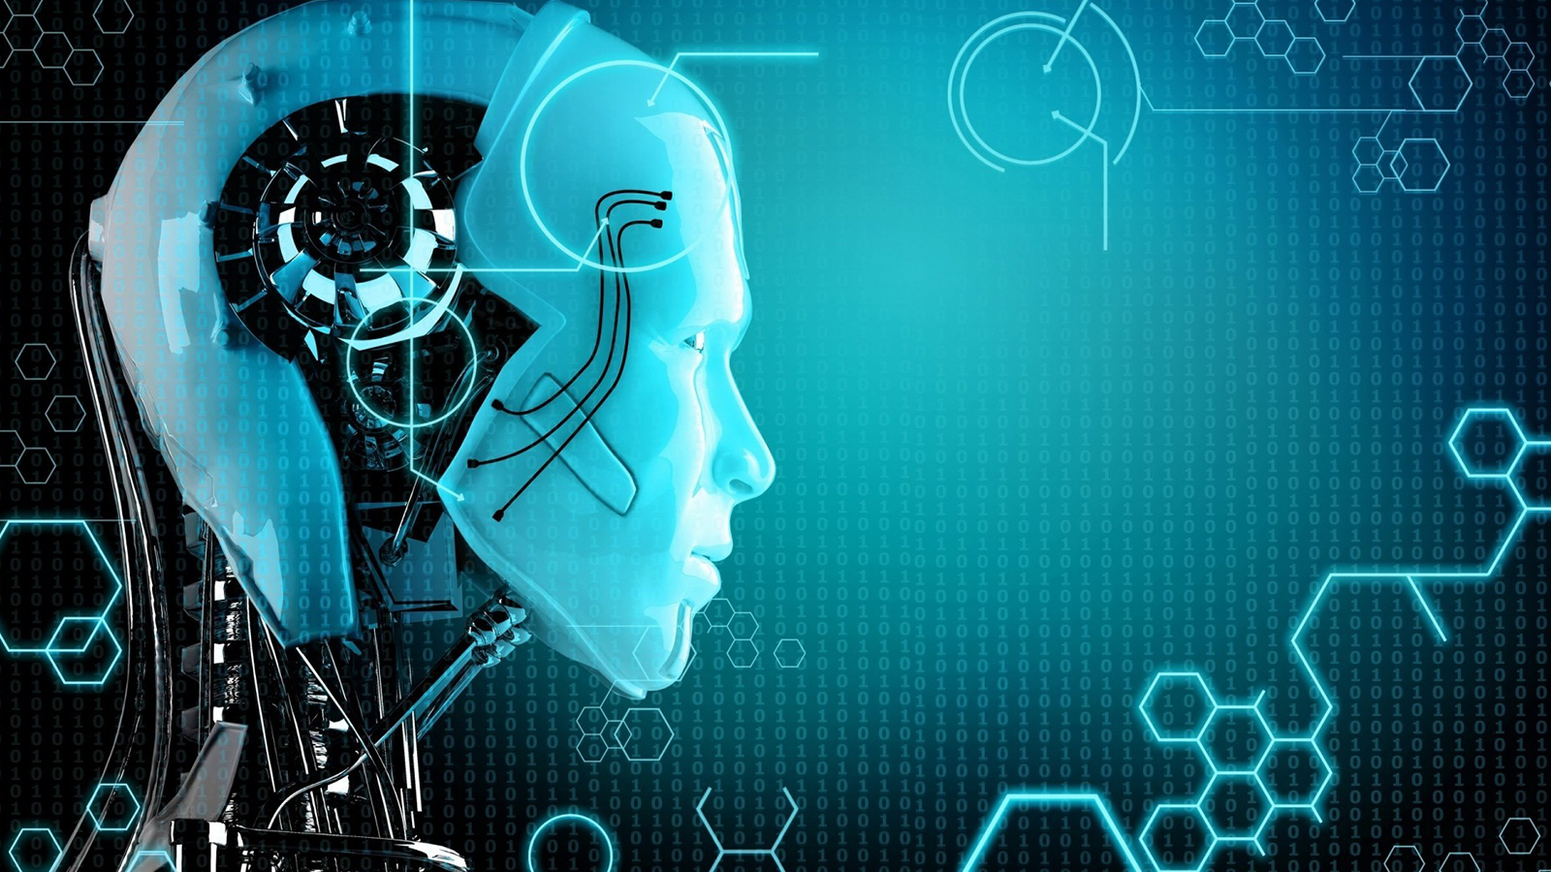
Self Study Guide

Slide 36
Self Study Guide
References
Solem, J.K. (2012). Programming Computer Vision with Python (1st ed.). Sebastopol, CA: O’Reilly.
Useful Sites
https://towardsdatascience.com/everything-you-ever-wanted-to-know-about-computer-vision-heres-a-look-why-it-s-so-awesome-e8a58dfb641e
https://opencv.org/
https://docs.opencv.org/4.5.2/d6/d00/tutorial_py_root.html
https://azure.microsoft.com/en-us/free/ (Microsoft Azure account)
https://azure.microsoft.com/en-us/services/cognitive-services/
https://algorithmia.com/

